Slide 1



MINDANAO: DIVERSE VOICES
Your Community
My Community

Slide 2
HUMAN VARIATIONS
ETHNIC DIVERSITY
SOCIAL DIFFERENCES
POLITICAL IDENTITIES
RELIGIOUS DIFFERENCES

Slide 3



RULES DURING THE FORUM
LISTENING
WALKING
CONFIRMING
CONVERSATION
This Photo by Unknown Author is licensed under CC BY-SA

Slide 4

Isa para sa
Mesa
Step 1
Step 1
One person responds
Step 2
Step 2
We all listen
Step 3
Step 3
We confirm what we heard

Slide 5


SOME FACTS IN MINDANAO
FROM UNDP REPORT
SOURCE: https://www.humanitarianresponse.info/sites/www.humanitarianresponse.info/files/documents/files/ocha-phl-consolidated-provincial-profiles-march-2018.pdf

Slide 6

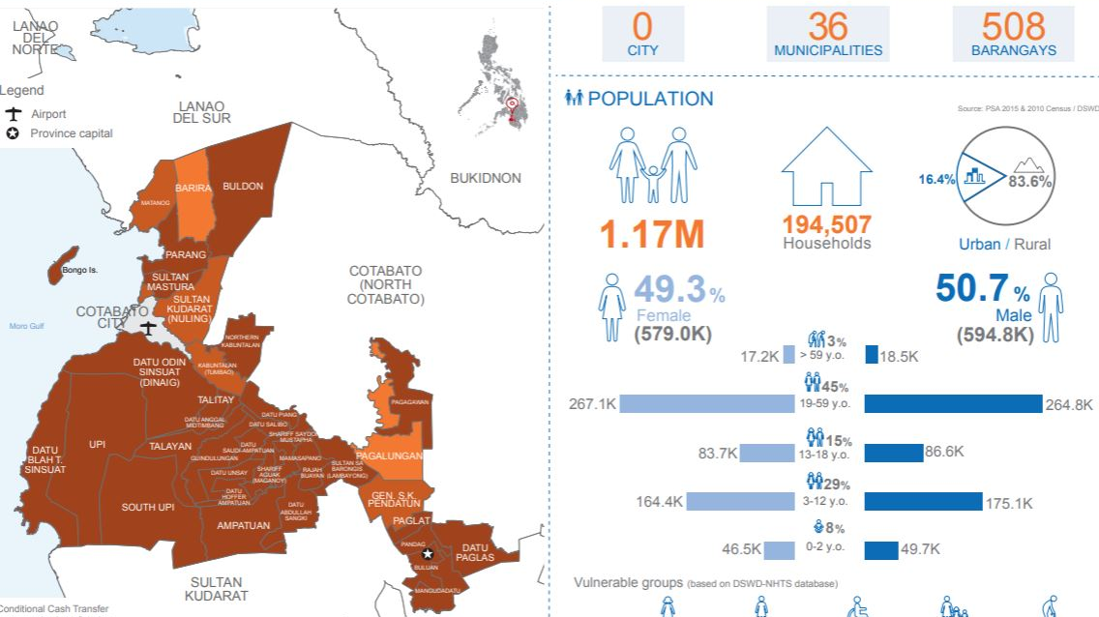
MAGUINDANAO

Slide 7
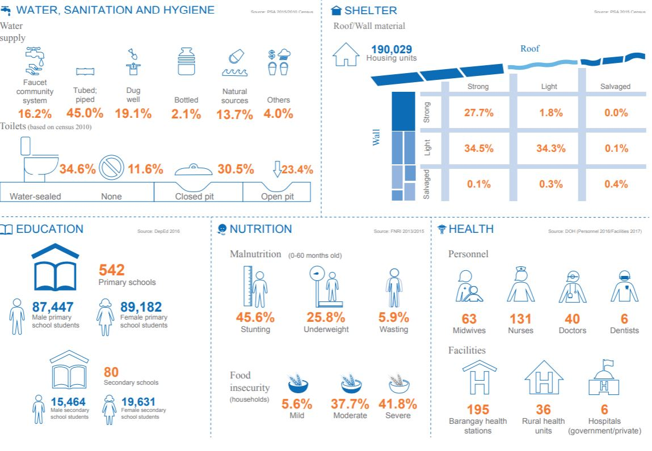

Slide 8

This Photo by Unknown author is licensed under CC BY.

Slide 9

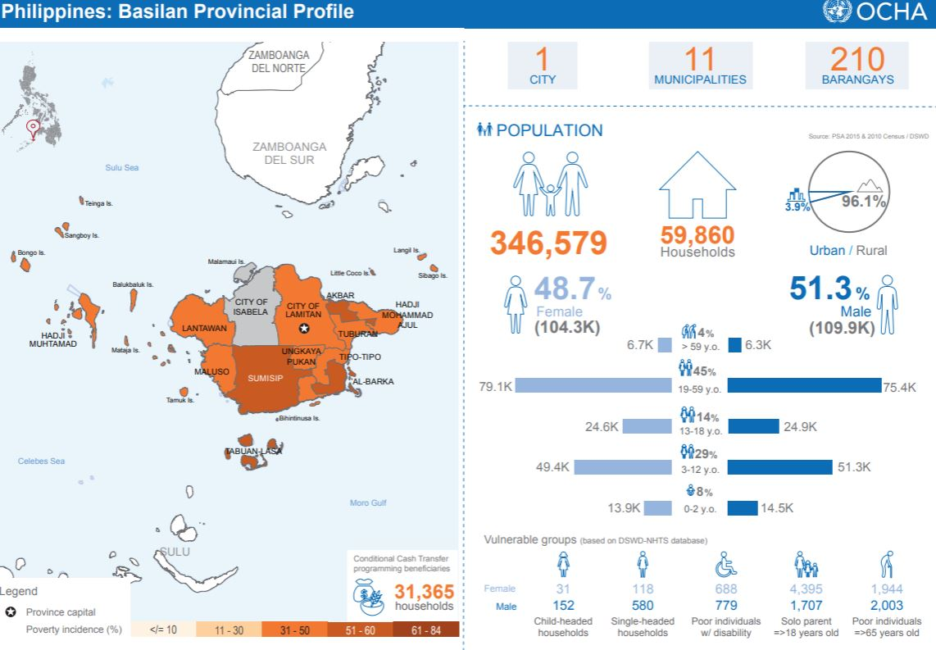


Slide 10
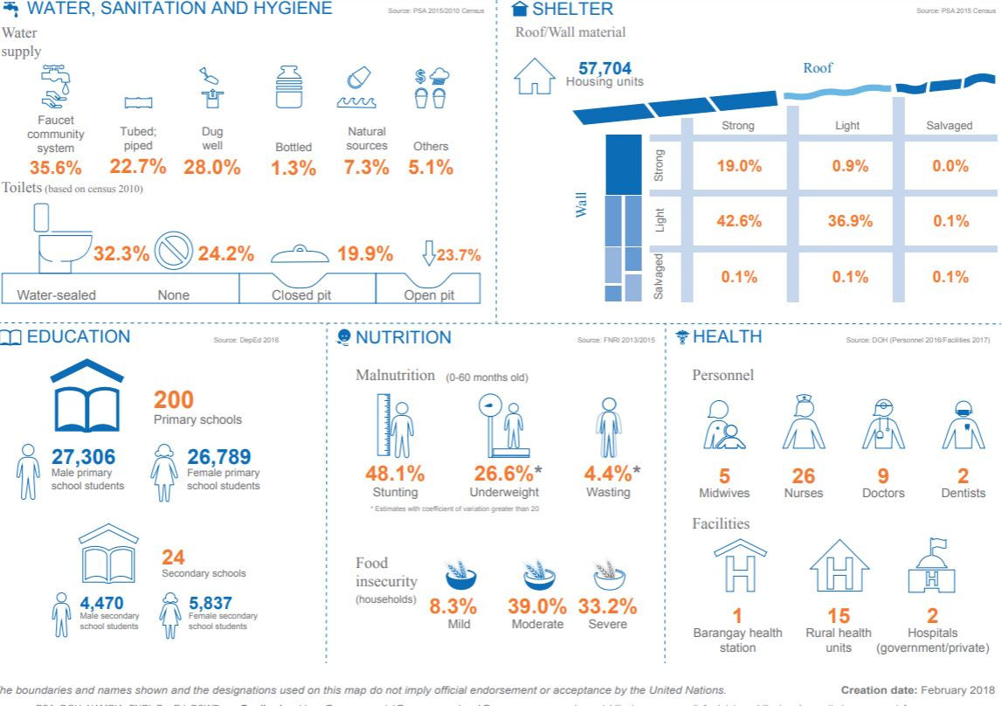

Slide 11
This Photo by Unknown author is licensed under CC BY.

Slide 12
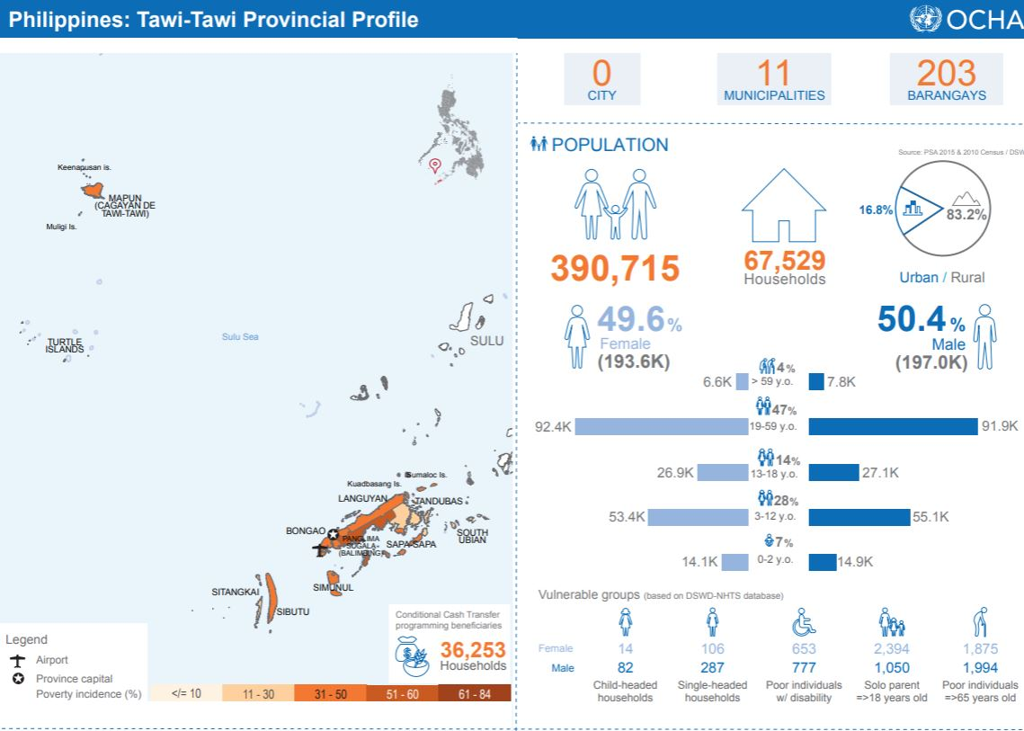

Slide 13
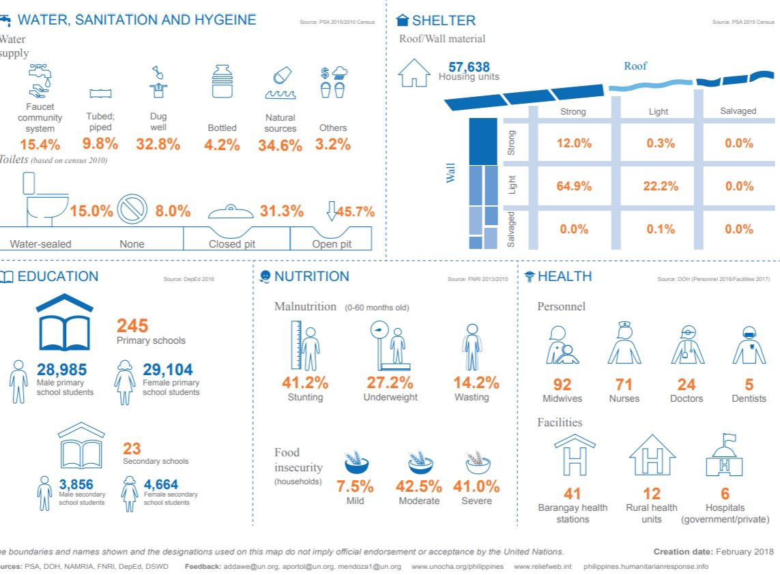

Slide 14
This Photo by Unknown author is licensed under CC BY.

Slide 15
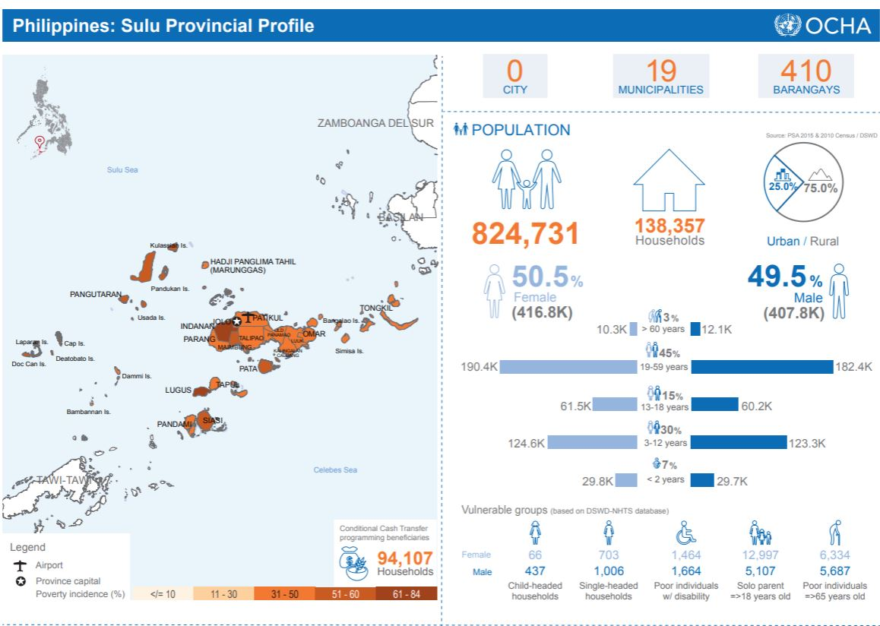

Slide 16
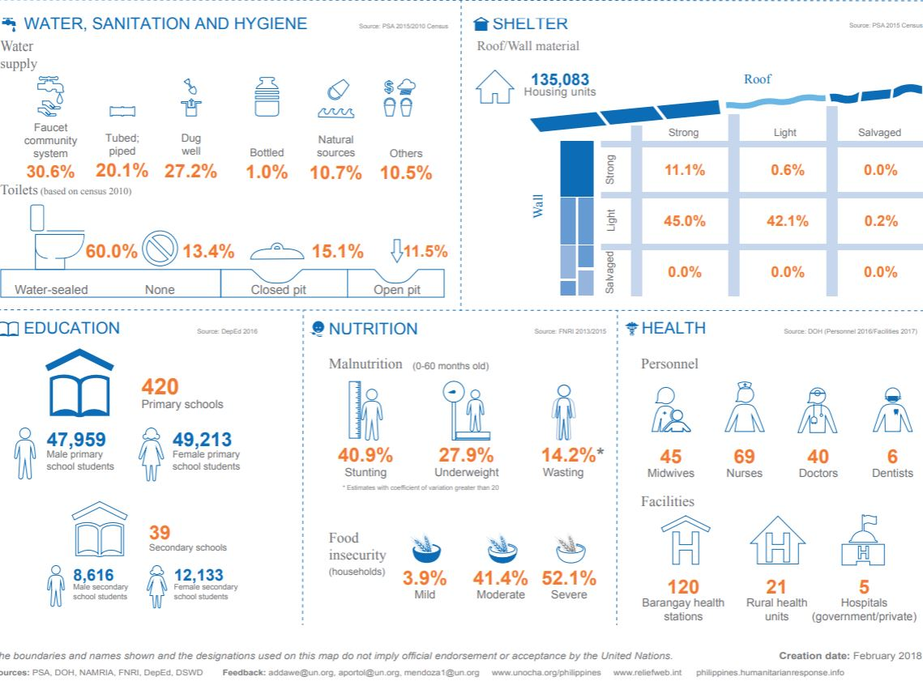

Slide 17
This Photo by Unknown author is licensed under CC BY.

Slide 18
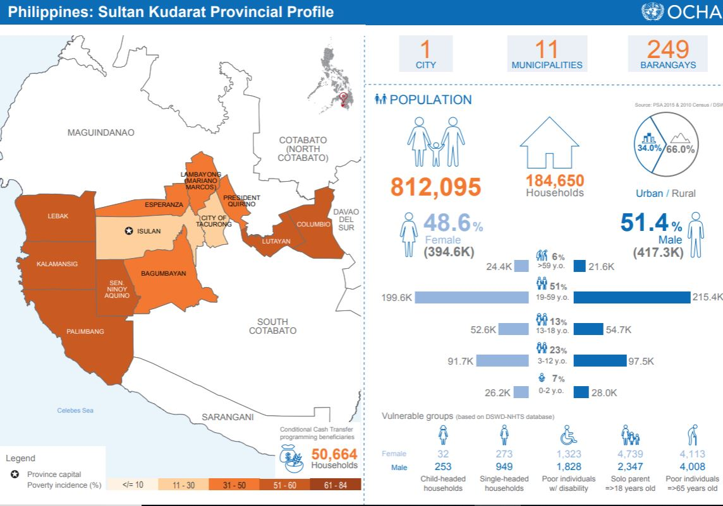

Slide 19
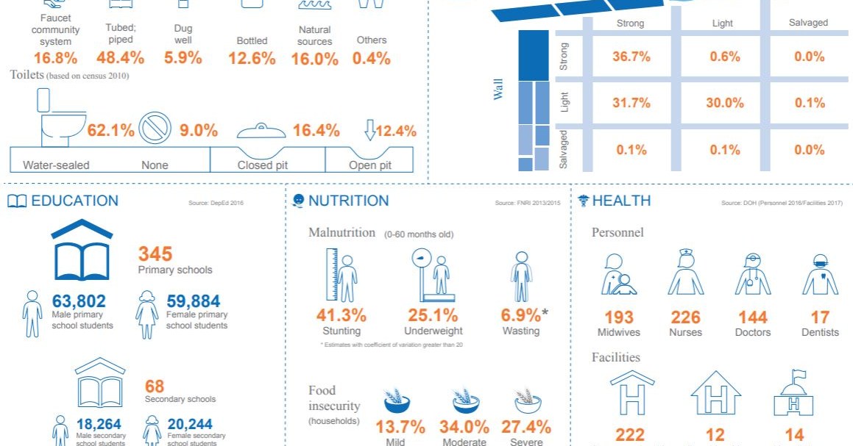

Slide 20
This Photo by Unknown author is licensed under CC BY.

Slide 21
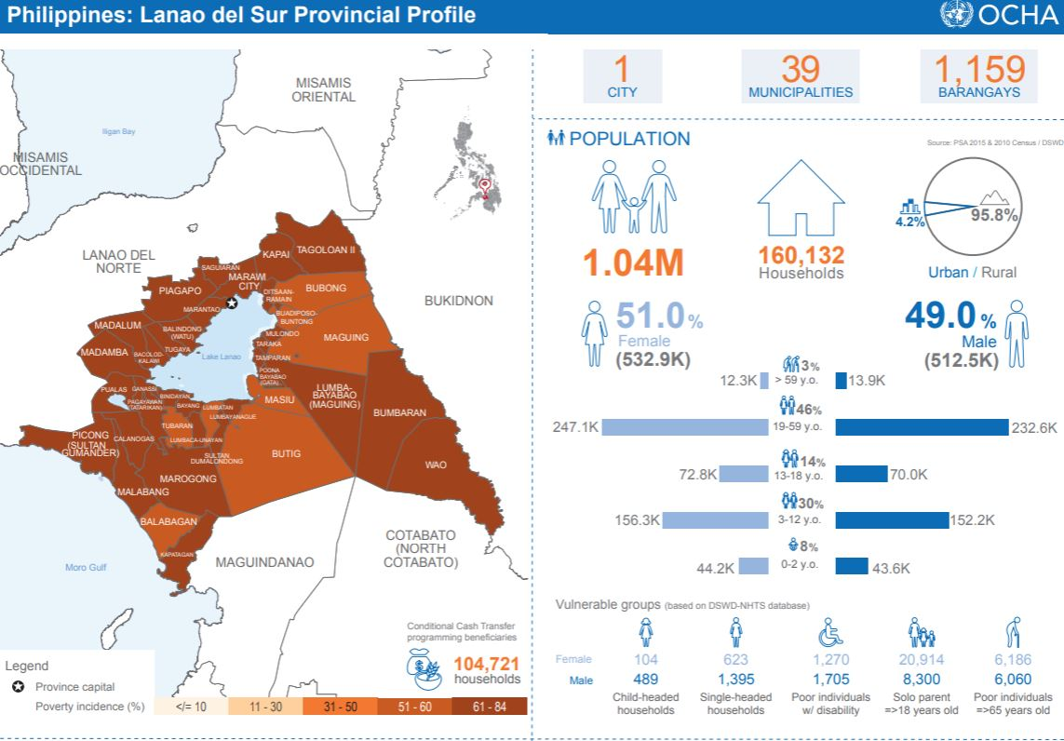

Slide 22
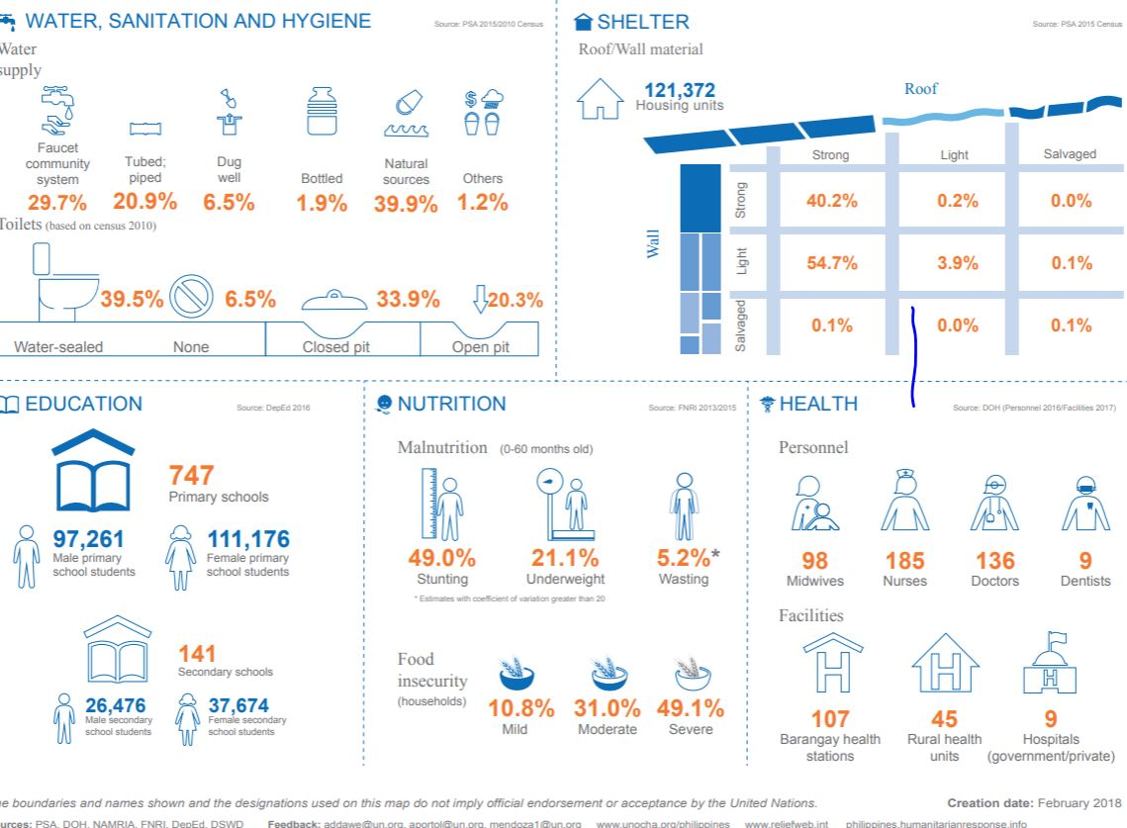

Slide 23
This Photo by Unknown author is licensed under CC BY.

Slide 24
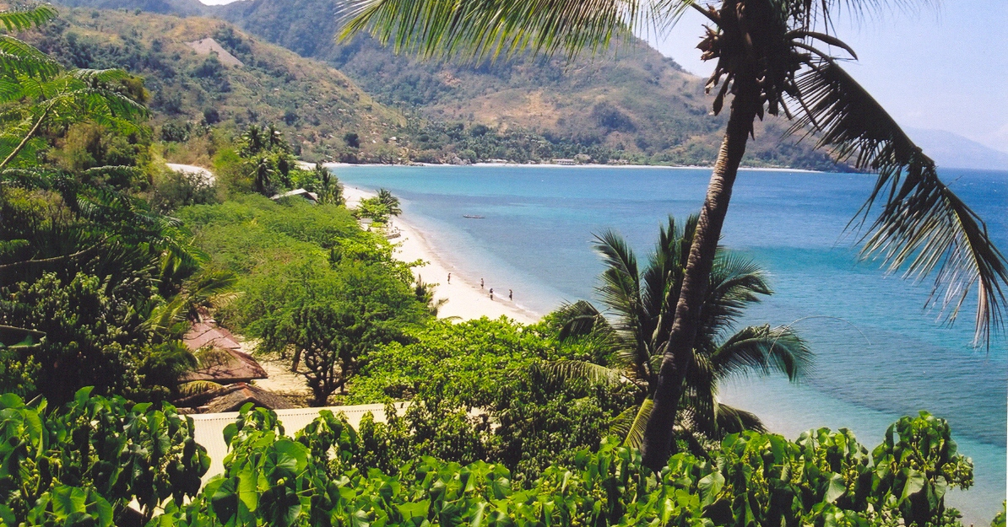
This Photo by Unknown author is licensed under CC BY-SA.

Slide 25
