Slide 1




Slide 2
Innovation Premium
The innovation premium is the proportion of a company’s market value that cannot be accounted for from the net present value of cash flows of its current products in its current markets. Put another way, it’s the premium the stock market gives a company because investors expect it to launch new offerings and enter new markets that will generate even bigger income streams. (Dyer and Gregersen 2017)
Dyer and Gregersen 2017

Slide 3
Is this the right problem?
Problem
Botrytis
Virus
Solution
Reframe the problem
Datar 2014

Slide 4
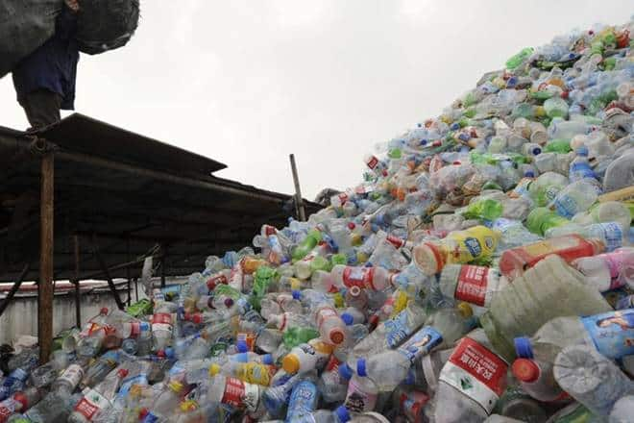



Design Thinking
The Maharashtra government’s decision to ban the use of plastic has been welcomed by environmentalists, but frowned upon by some stakeholders who feel that lakhs of people will be rendered jobless in the Rs 50,000 crore industry. The government had earlier rejected the pleas of some players from the plastic industry to reconsider the decision on ban, saying “today’s pain is tomorrow’s gain”. On March 23, the Maharashtra Plastic and Thermocol Products notification was issued to ban the manufacture, use, storage, distribution, sale, import and transportation of all kinds of plastic items.
Better Solution?

Slide 5
Design Thinking
Innovation
Knowing
Doing
Being
Operation

Slide 6
Learning by Doing
Informed decision requires knowledge
Knowing – Doing gap
How to make decisions under ambiguity
How to make decisions without structure

Slide 7
Being Self-Aware
Self-Aware
Understand others
Influence others
Motivate Others
Inspire others

Slide 8
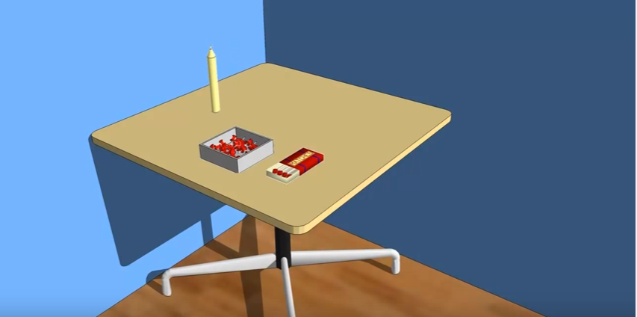
Fixedness
Understanding Fixedness
Functional
Structural
Breaking Fixedness
Add a new function to an existing resource
Relational
Candle
Tie the ropes
Datar 2014
Notes:
The wall board
Eco-faucet
Solar panel on traffic sign
Uber
Camera on phone exercise

Slide 9
Fixedness
Understanding Fixedness
Functional
Structural
Breaking Fixedness
Divide
Relational
9-Dots
5-coins
Datar 2014
Notes:
This class project

Slide 10
Fixedness
Understanding Fixedness
Functional
Structural
Breaking Fixedness
Relate in a different way
Relational
Datar 2014
Notes:
Reward wellness

Slide 11
Innovation is Design
Emotional
People (Desirable)
Business (Viable)
Technology (feasible)
Functional
Experiential
Process

Slide 12
Innovation
Multi-stage rockets
Levitronix
Required
Desired
Constraints
Opportunities

Slide 13
Principles of Good Design
Good design is invisible
Good design is Human Centered
Good design solves the right problem
Good design balances technology with psychology
Norman 2013

Slide 14
The Double Diamond Design Process
FINDING THE RIGHT PROBLEM
FINDING THE RIGHT SOLUTION
Drill bit
E-books
Divergence
Convergence
Divergence
Convergence
TIME
Norman Don. The Design of Everyday Things 2013

Slide 15
Group Project- Board game
Design
Develop
Market
Present a business case

Slide 16
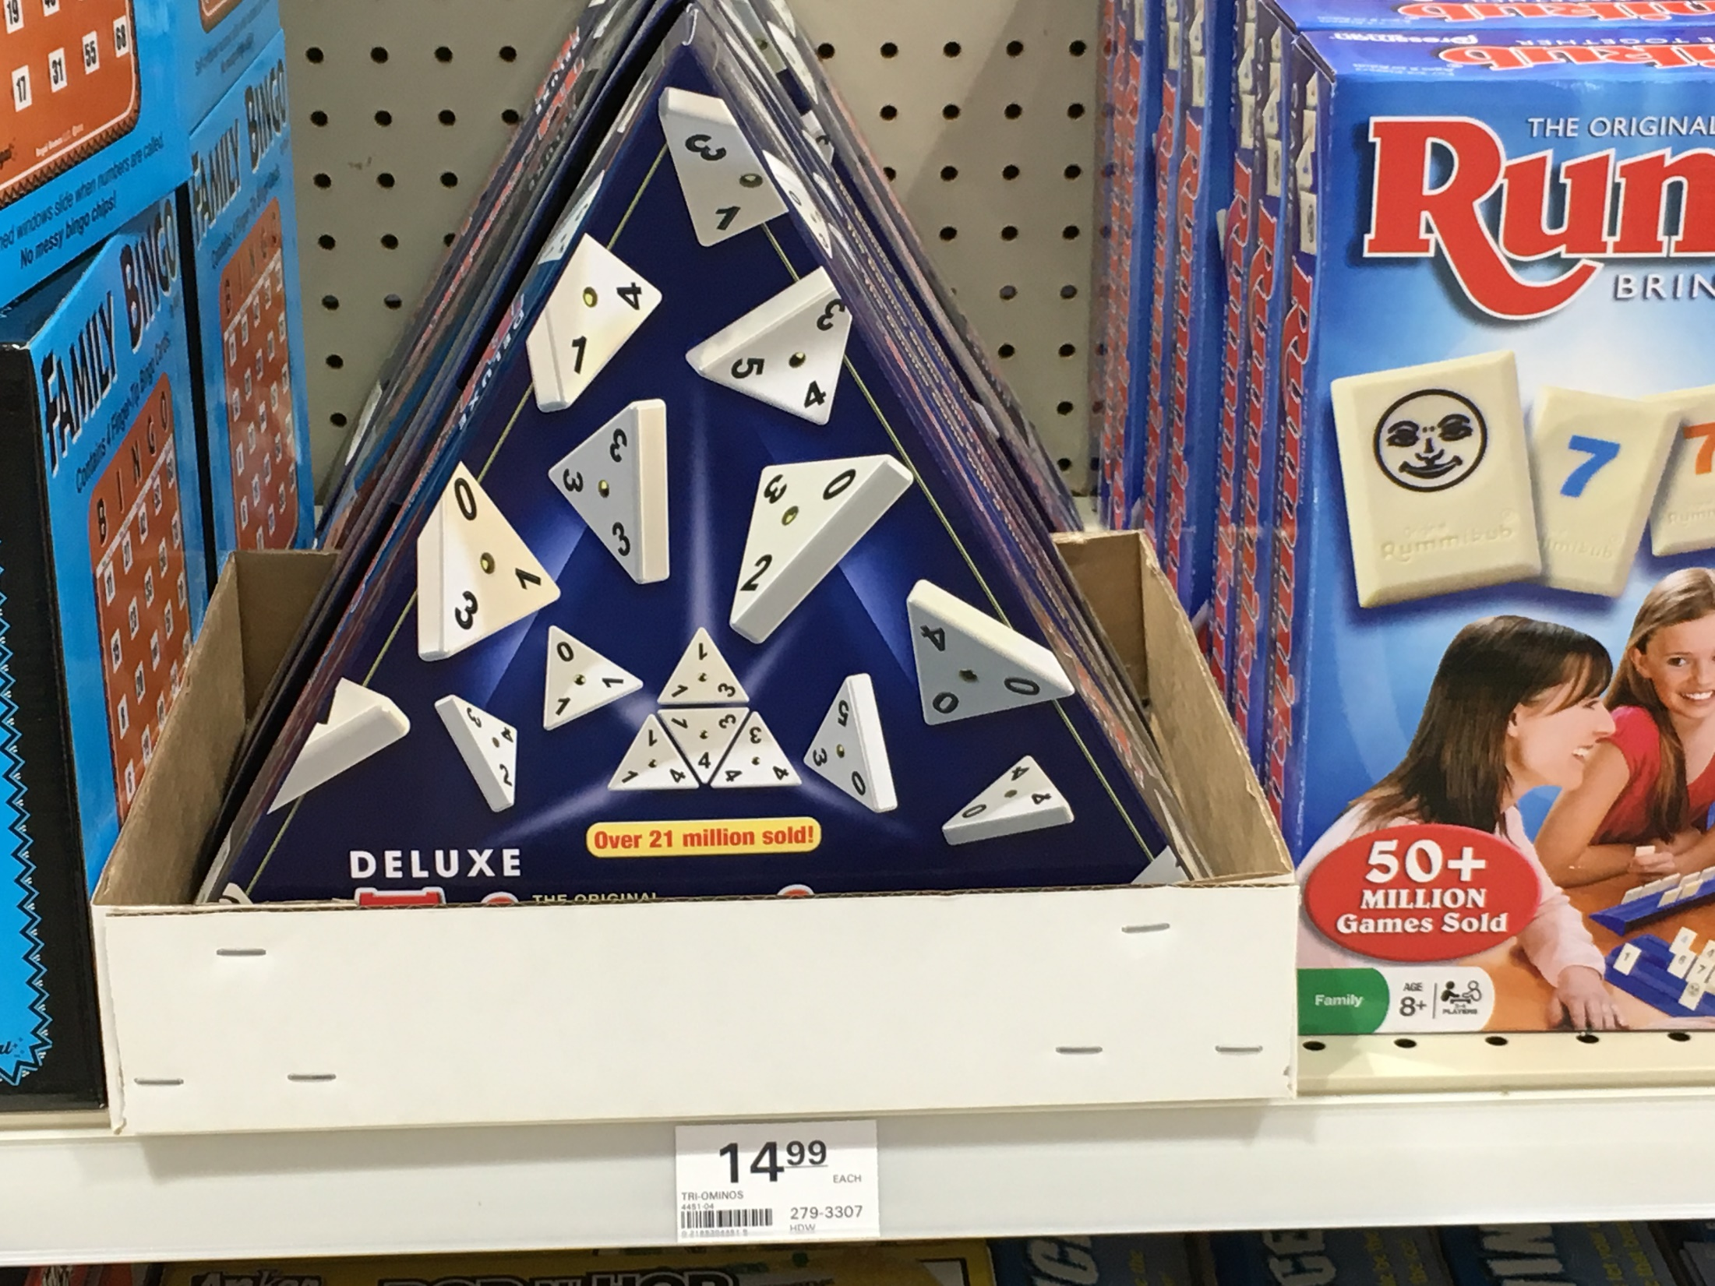

Slide 17
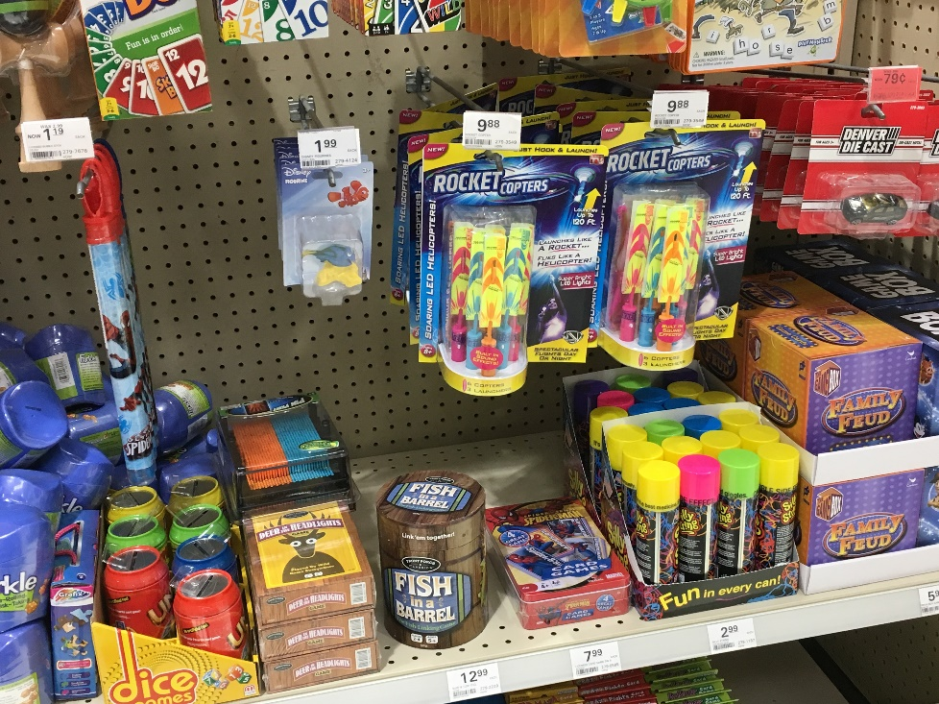
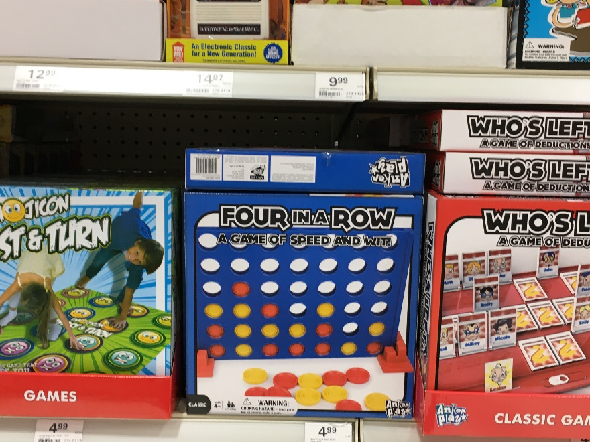
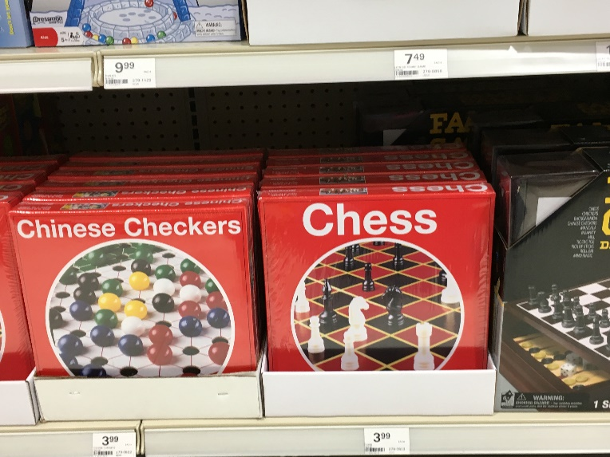
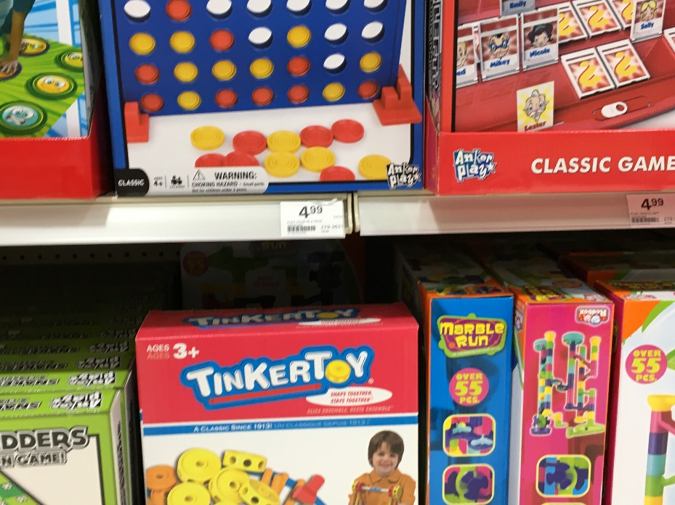
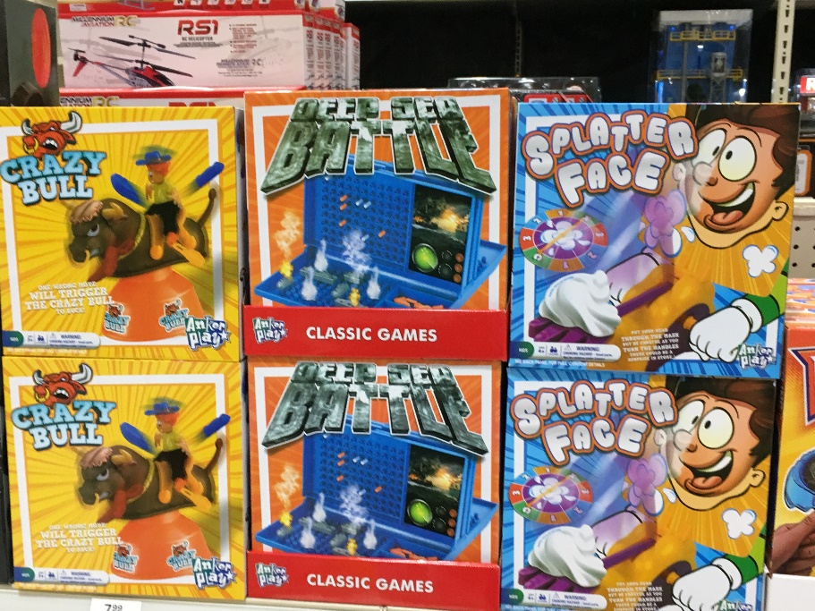

Slide 18

Damru

Slide 19
Group Project
Design a new board game with a social cause
Family game - Bonding
Party game - Fun
Educational game – Skill, Knowledge, Language
Skill based games – Fastest finger on the buzzer?

Slide 20
Devices
Cards
Dices
Chips
Coins
Flash cards
…

Slide 21
Issues to consider
Use smart phones somehow
text or timer
Music
Google a word or something
Fitness
Target segment
Usage Occasion
Powered or Mechanical

Slide 22
Human Centered Design Thinking Process
Empathize
Define
Ideate
Prototype
Test
Plattner H. An Introduction to design Thinking process

Slide 23
Each group divide into two subgroups
Develop an idea in each sub group

Slide 24
Gain Empathy
1
2
Develop an idea
in your subgroup
Share your idea with
the other sub group
and take feedback
10 MIN
10 MIN

Slide 25
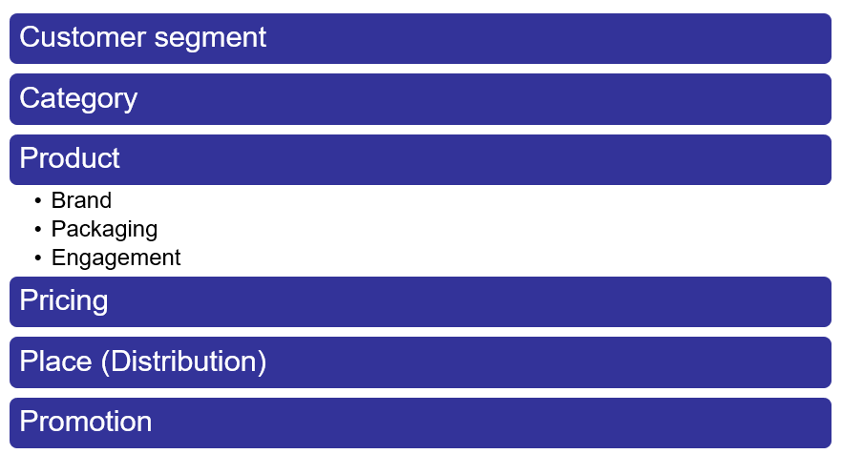
Define
3
Now see if you can
  combine the ideas
  or create a new idea
  or agree to go with one of the ideas
Who will play these games?
What are the rules?
How will it be played?
What message will it send?
20 MIN

Slide 26
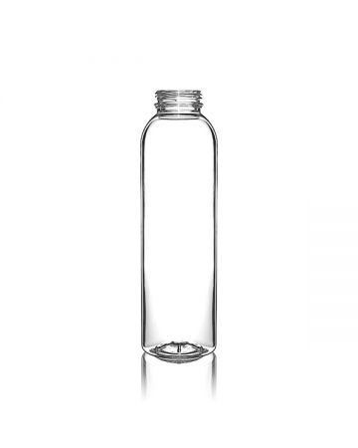
Ideate: Generate Alternatives- DRAW!
4
A quick rough design
10 MIN

Slide 27
Prototype
5
Give your idea a shape → Create a prototype
  Cut
  Stick
  Color
  Paste
30 MIN

Slide 28
9
Share your solutions with another group and capture feedback
What worked
What could be improved
New questions
New ideas
20 MIN

