Slide 1
Appreciative Inquiry
Visioning and Goal Casting

Slide 2
Goals for the Workshop
To DISCOVER what is best in the community
To DREAM what the community could be
To DESIGN what the community should be
To innovate a DESTINY for the community

Slide 3
What is Appreciative Inquiry or AI?
Why use AI?
How to use AI?
When to use ?
Where to use AI?

Slide 4

Appreciative Storytelling
Share a positive story
Or
Share an encouraging story about others in the community
This Photo by Unknown Author is licensed under CC BY
This Photo by Unknown Author is licensed under CC BY

Slide 5
Appreciative Roleplay
Peaceful Dialog
Community Case Study
Scenarios
Group 1
Group 2
Group 3
Group 4
Group 5
Group 6

Slide 6
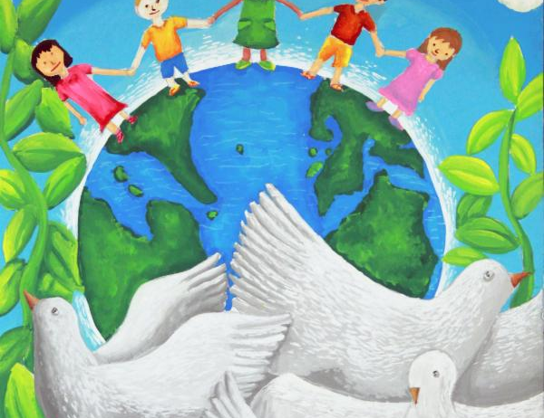
Appreciative Art (Yarn, Nails and Boards)
Everyone is born to create!
This Photo by Unknown Author is licensed under CC BY-SA

Slide 7
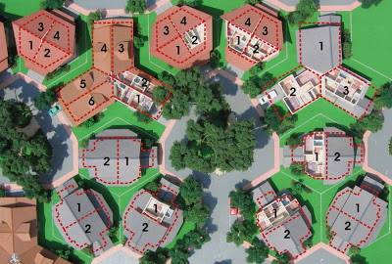
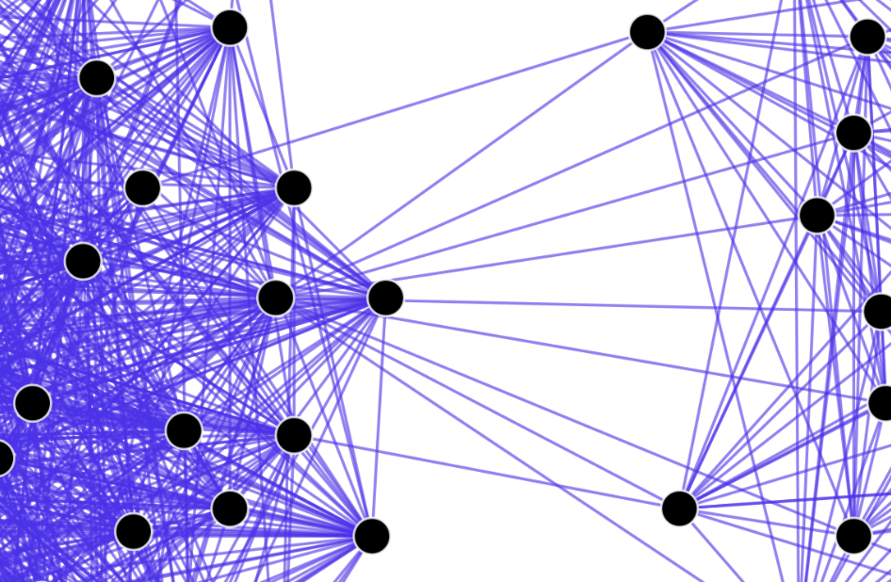
Appreciative Planning and Action
This Photo by Unknown Author is licensed under CC BY-NC
This Photo by Unknown Author is licensed under CC BY-SA
CONCEPTS IN BUILDING COMMUNITY
PERSPECTIVES IN BUILDING COMMUNITY

Slide 8
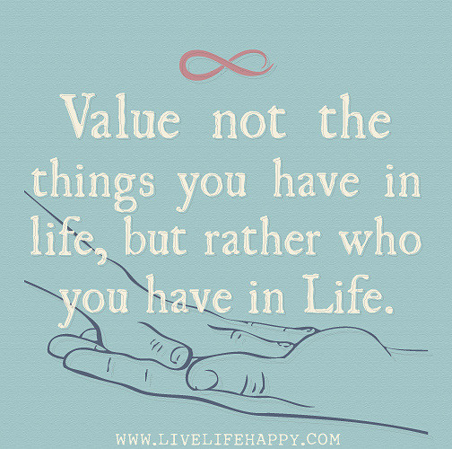


Appreciative Acknowledgement Bag
This Photo by Unknown Author is licensed under CC BY-SA-NC
This Photo by Unknown Author is licensed under CC BY-NC-ND
This Photo by Unknown Author is licensed under CC BY-SA-NC
I value your_________
I thank you for __________
I appreciate your ________

Slide 9
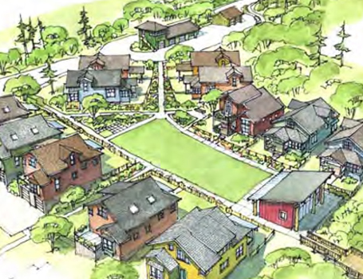
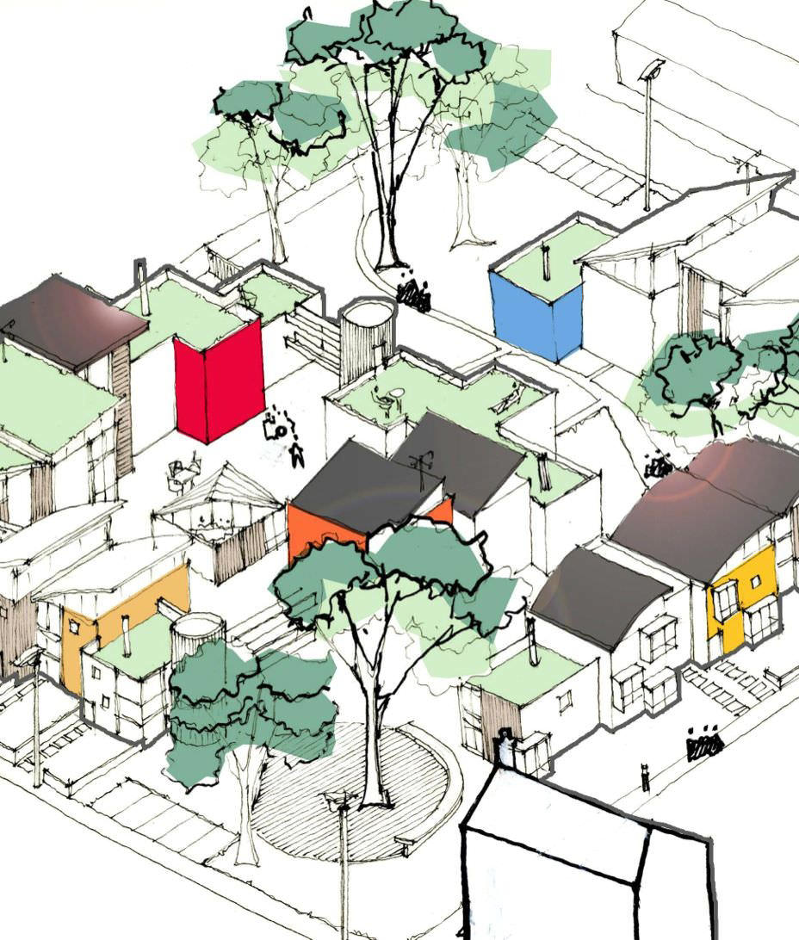
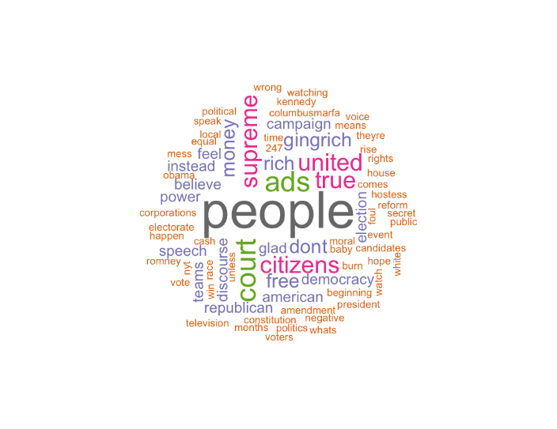
APPRECIATIVE COMMUNITY PLANNING
ENVISION
INSPIRE
IMPROVE
This Photo by Unknown Author is licensed under CC BY-NC-ND
This Photo by Unknown Author is licensed under CC BY-SA-NC
This Photo by Unknown Author is licensed under CC BY-SA

Slide 10
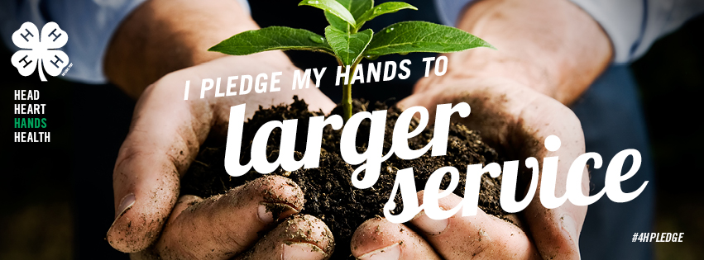
APPRECIATIVE COMMITMENT
(Canvass and acrylic paint)
This Photo by Unknown Author is licensed under CC BY-SA-NC

Slide 11
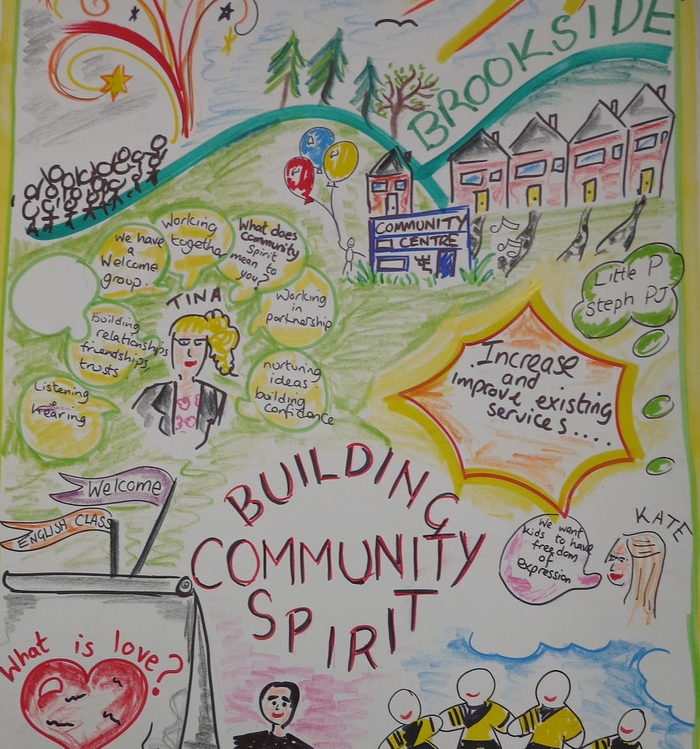
APPRECIATIVE CREATION (Community Diorama)
This Photo by Unknown Author is licensed under CC BY-SA-NC

Slide 12

This Photo by Unknown Author is licensed under CC BY

